Slide 1



Who Works Here?
Notes:
A presentation to showcase the range of opportunities available within a certain area

Slide 2
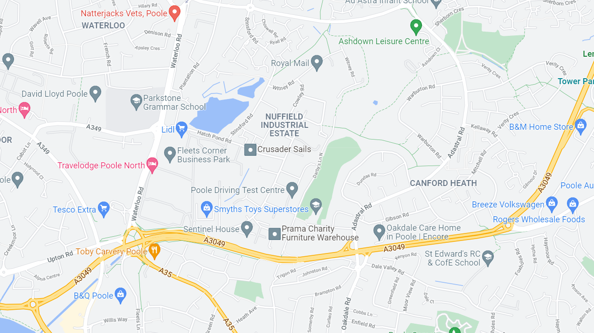
Nuffield Industrial Estate
Notes:
Point out where your school is on the map

Slide 3
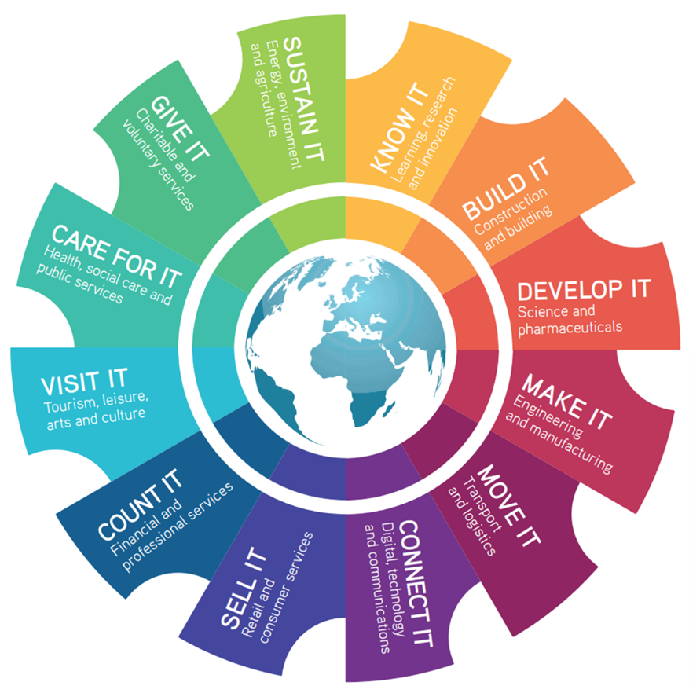
What interests you?
Notes:
Have a look at the different sectors within this wheel. What interests you? What doesn’t? Note down the ones that interest you the most

Slide 4
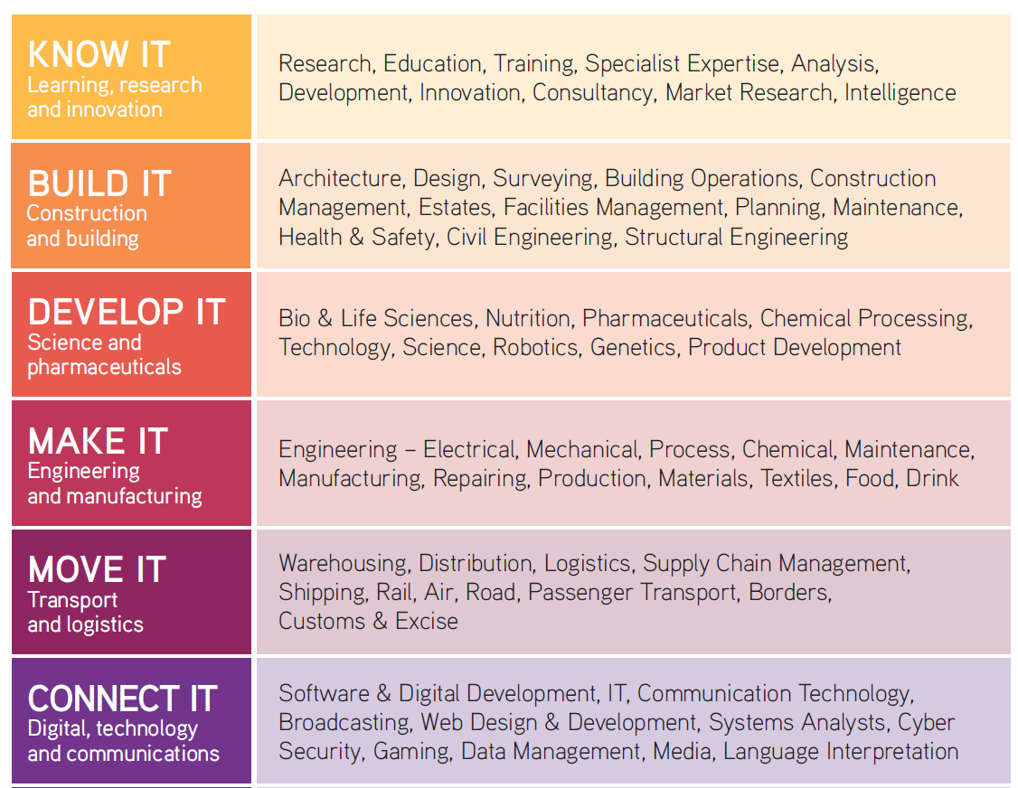
What interests you?
Notes:
Here it shows which jobs are within these sectors. Do the ones you that have written down still interest you?

Slide 5
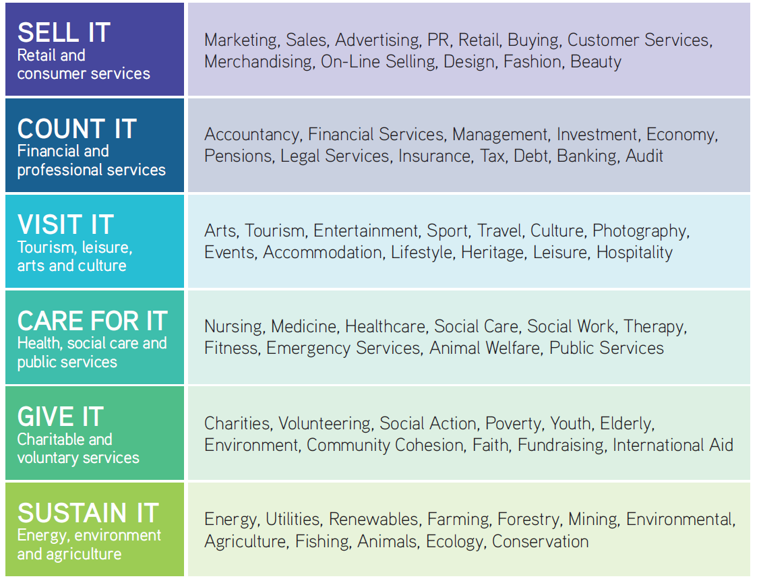
What interests you?

Slide 6
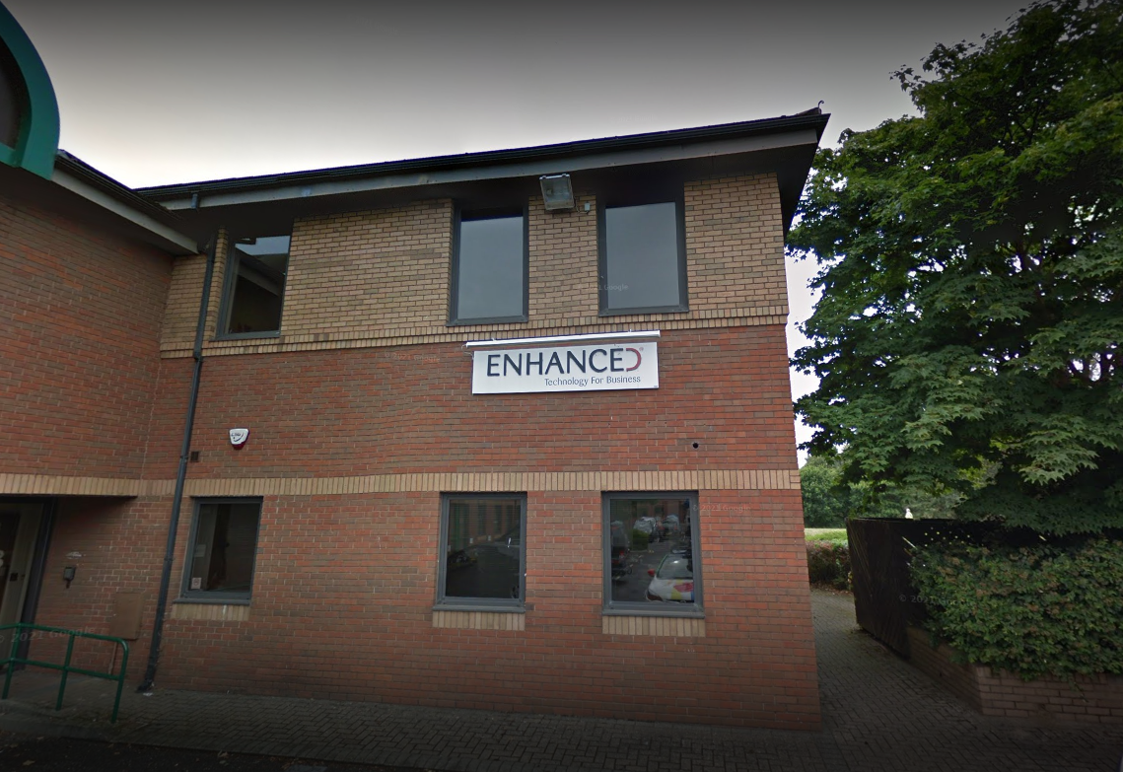
Company Name - Enhanced
Company Sector - Technology
Company Size - 48 people
Description
Enhanced are an IT provider for other businesses. We offer:
IT systems which help manufacturers, warehouses and professional services like solicitors. The IT systems support things like finance processes, keeping track of orders and stock.
IT infrastructure such as cloud, security and networks. We also supply hardware like laptops and all the components within them.
Types of roles within the business
IT support helpdesk, IT engineers, system consultants, system developers (code), marketing, business support (finance, admin, reception).
Notes:
Company 1 – Based on the Nuffield Industrial Estate

Slide 7
Enhanced are a “Connect It” business.
Our IT supports other companies who:
Build It
Make It
Move It
Sell It
Count It
Care for It
Give It
Notes:
Show of hands for anyone that wrote ‘Connect It’ down – Does this company interest you?

Slide 8
Watch this video to see what we do:
https://youtu.be/J_E4h-3eHlY

Slide 9

Composite Profiles
Company Name – Composite Profiles UK Ltd
Company Sector – Construction
Company Size – 25 employees
Description
Composite Profiles UK Limited is a specialist supplier and installer of
composite metal floor and roof decks. Our long-standing specialised experience ensures intuitive delivery of first class solutions to the very highest standards. From effective and accurate specification and quoting, through to efficient supply and expert installation by teams of highly trained and experienced site operatives, Composite Profiles delivers a world-class level of service throughout the UK.
Types of roles within the business
Project Management, CAD Design, Estimation, Commercial, Business Development, Sales, Surveying
Finance & Administration
Notes:
Company 2 – Based on the Nuffield Industrial Estate

Slide 10
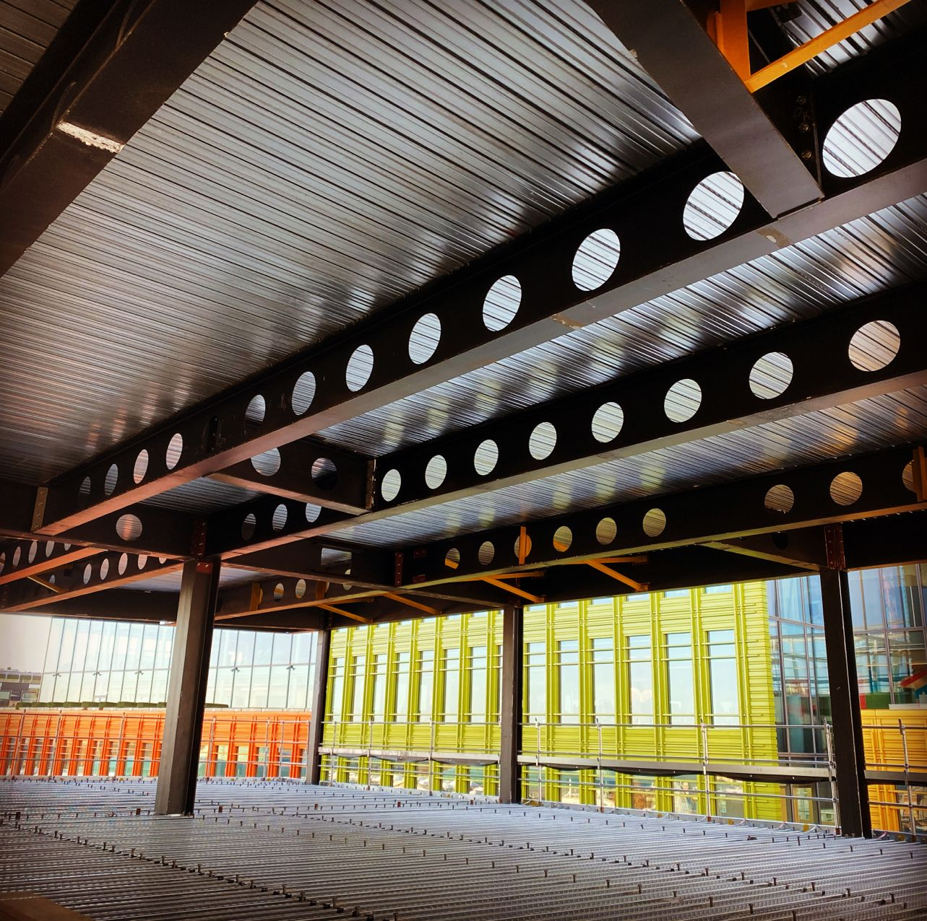
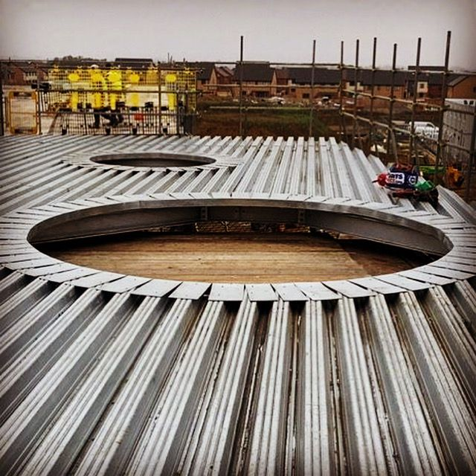
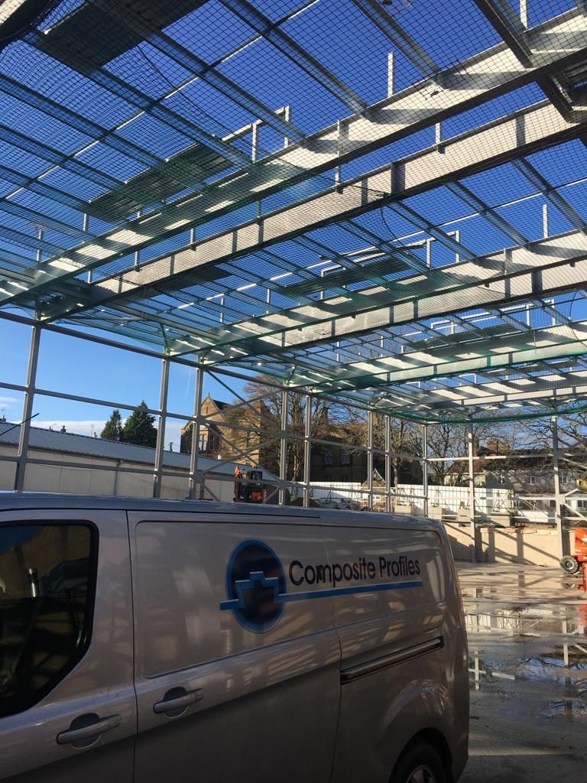
Composite Profiles
Notes:
These are photos from some of the sites they have worked on showcasing what they do

Slide 11
Composite Profiles
Composite Profiles UK are primarily a ‘Build It’ business.
But have employees within roles linked to:
Know It
Develop It
Make It
Move It
Connect It
Count It
Sustain It
Notes:
Show of hands for anyone that wrote ‘Build It’ down – Does this company interest you?

Slide 12

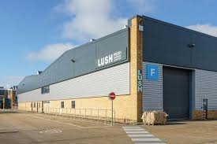
Lush
Company Name - Lush
Company Sector – Cosmetics Manufacturer & Retailer
Company Size – 1,500 employees & over 20 buildings in Poole
Description Creators of pioneering beauty products such as the fizzing bath bomb, shower jellies and solid shampoo bars, we place emphasis on fresh ingredients like organic fruits and vegetables, fight against animal testing and combat over-packaging by developing products that can be sold ‘naked’ to the customer without any packaging.
Types of roles within the business
Retail, Manufacturing, Communications, Finance, Marketing,
Business Development, Human Resources, Product Development,
Buying, Digital, Maintenance, Process Improvement, Procurement,
Management, Engineering, Warehouse and Microbiology.
Notes:
Company 1 – Based on the Nuffield Industrial Estate

Slide 13
Lush Globally 2022

Slide 14
Lush
Lush are a ‘Sell It’ and ‘Make It’ business.
But have employees within roles linked to:
Know It
Build It
Develop It
Move It
Connect It
Count It
Visit It
Sustain It
Notes:
Show of hands for anyone that wrote ‘Sell It’ or ‘Make It’ down – Does this company interest you?

Slide 15
Lush
Watch the video to see what we do:
Nuffield – Video - Lush
Notes:
Play the video on the website provided with this presentation

Slide 16

James Fisher Prolec
Company Name – James Fisher Prolec
Company Sector – Engineering/Construction
Company Size – 30 people
Description
With 30+ years innovation in electronics and software, Prolec provides a range of safety and control systems for construction equipment
Types of roles within the business
Project Management, Electronics, Engineering, Commercial, Operations, Business Development, Sales, Finance & Administration

Slide 17
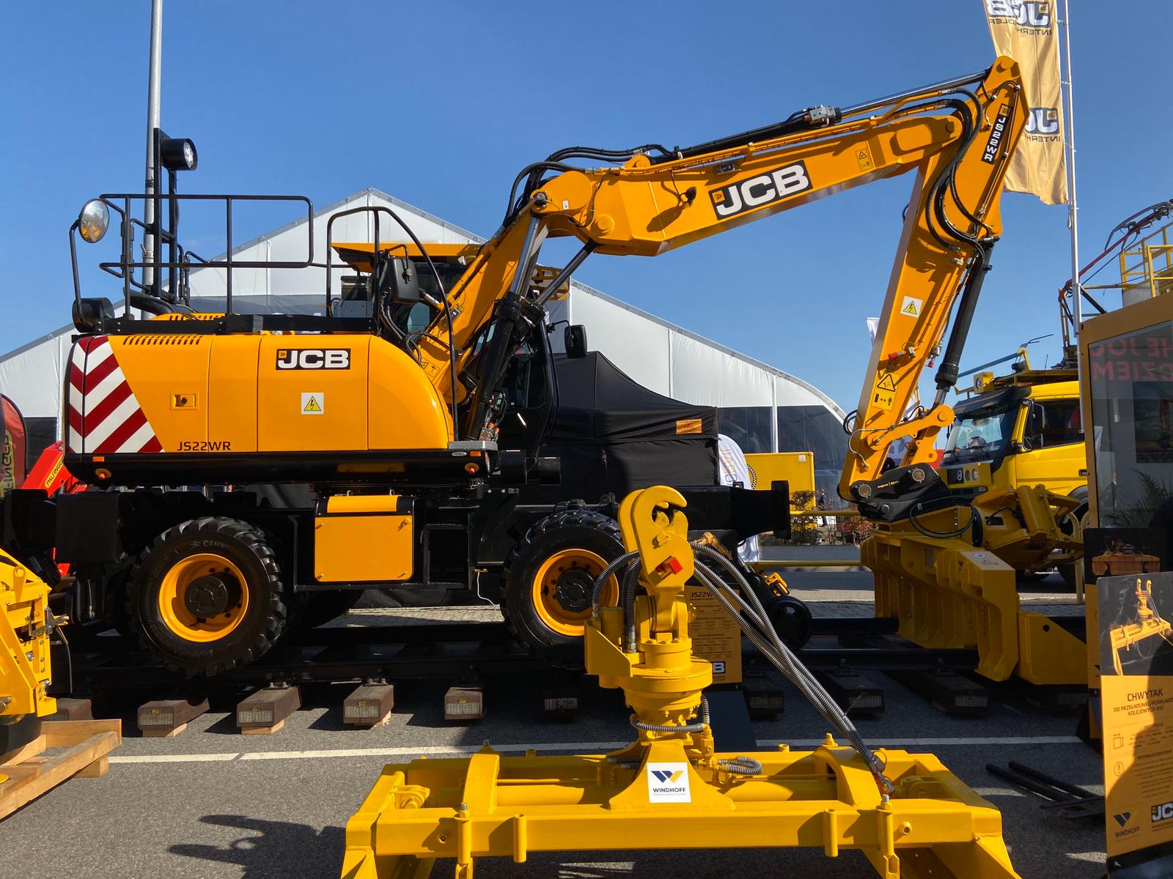
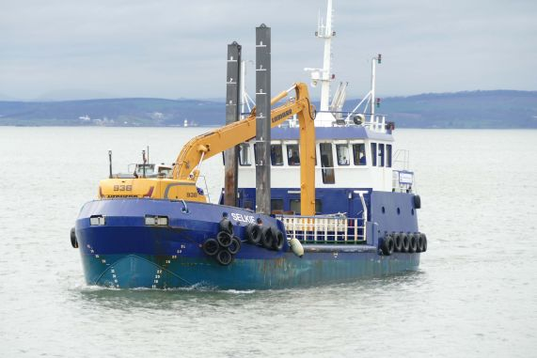

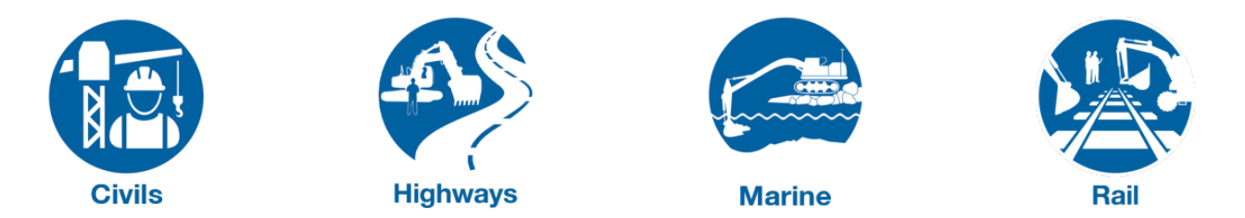
James Fisher Prolec

Slide 18
James Fisher Prolec
Prolec are primarily a ‘Develop It’ business.
But have employees within roles linked to:
Know It
Build It
Make It
Move It
Connect It
Sell It
Count It
Sustain It

Slide 19
James Fisher Prolec
Watch the video to see what we do:
Nuffield – Video - Prolec

